Slide 1
UNIT IV
Capital Budgeting

Slide 2
Outcome
Appraise the concept of internal rate of return method and analyze the significance of IRR in investment decisions.

Slide 3

News Analysis
https://www.thehindubusinessline.com/economy/india-incs-overseas-borrowings-back-on-track/article33552598.ece?homepage=true

Slide 4
Internal Rate of Return (IRR) Method
The internal rate of return (IRR) method is another discounted cash flow technique, which takes account of the magnitude and timing of cash flows. Other terms used to describe the IRR method are yield on an investment, marginal efficiency of capital, rate of return over cost, time adjusted rate of internal return.
IRR is the rate that equates the investment outlay with the present value of cash inflow received after one period.

Slide 5
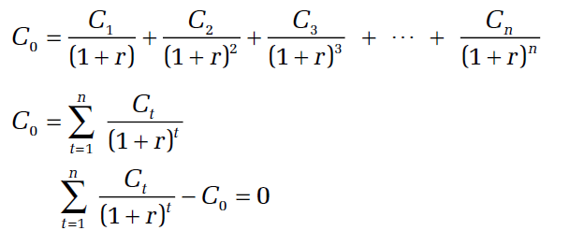
Contd…..
This also implies that the rate of return is the discount rate which makes NPV = 0. There is no satisfactory way of defining the true rate of return of a long-term asset. IRR can be determined by solving the following equation for r:

Slide 6
MCQ
Internal rate of return is …
Rate at which discounted cash inflow is more than discounted cash outflow
Rate at which discounted cash inflow is less than discounted cash outflow
Rate at which discounted cash inflow is equal to the discounted cash outflow
Either a or b

Slide 7
Answer
C. Rate at which discounted cash inflow is equal to the discounted cash outflow

Slide 8
Illustration
Assume that you deposit ₹ 10,000 with a bank and would get back ₹ 10,800 after one year. The true rate of return on your investment would be?
8.25%
7.75%
8.00%
None of the above

Slide 9
Calculation of IRR (Uneven Cash Flows)
Calculating IRR by Trial and Error
  The approach is to select any discount rate to compute the present value of cash inflows. If the calculated present value of the expected cash inflow is lower than the present value of cash outflows, a lower rate should be tried. On the other hand, a higher value should be tried if the present value of inflows is higher than the present value of outflows. This process will be repeated unless the net present value becomes zero.

Slide 10
Illustration
A project costs ₹ 16,000 and is expected to generate cash inflows of ₹ 8,000, ₹ 7,000 and ₹ 6,000 at the end of each year for next 3 years.

Slide 11
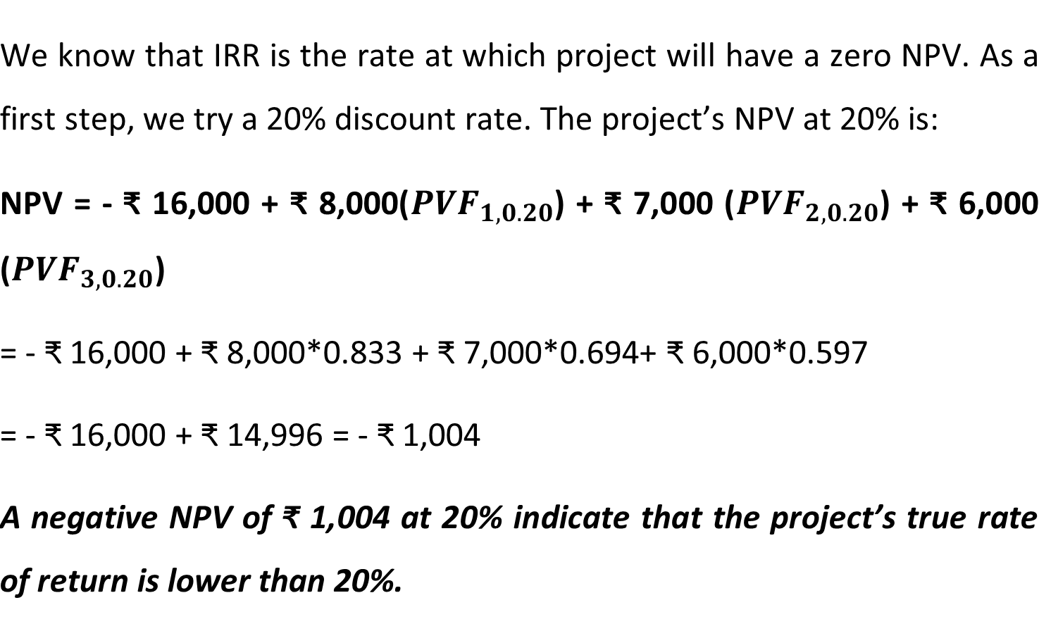
Solution

Slide 12
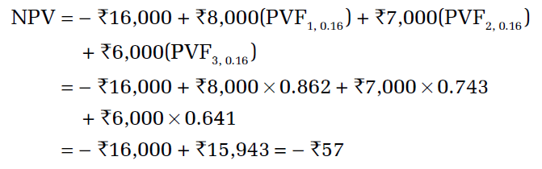
Contd….
Let us try 16 per cent as the discount rate. At 16 per cent, the project’s NPV is:
Since the project’s NPV is still negative at 16 per cent, a rate lower than 16 per cent should be tried.

Slide 13
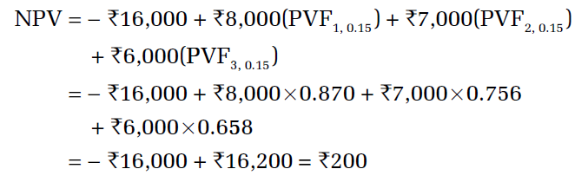
Contd…..
When we select 15 per cent as the trial rate, we find that the project’s NPV is ₹200:
The true rate of return should lie between 15–16 per cent.

Slide 14
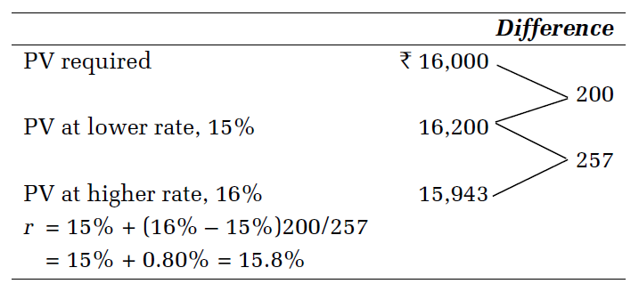
Contd….
We can find out a close approximation of the rate of return by the method of linear interpolation as follows:

Slide 15
MCQ
Which of the following statements is correct regarding the internal rate of return (IRR) method?
Each project has a unique internal rate of return.
As long as you are not dealing with mutually exclusive projects, capital rationing, or unusual projects having multiple sign changes in the cash-flow stream, the internal rate of return method can be used with reasonable confidence.
The internal rate of return does not consider the time value of money.
The internal rate of return is rarely used by firms today because of the ease at which net present value is calculated.

Slide 16
Answer
b) As long as you are not dealing with mutually exclusive projects, capital rationing, or unusual projects having multiple sign changes in the cash-flow stream, the internal rate of return method can be used with reasonable confidence.

Slide 17
Acceptance Rule for IRR
Accept the project when r > k
Reject the project when r < k
May accept the project when r = k
In case of independent projects, IRR and NPV rules will give the same results if the firm has no shortage of funds.

Slide 18
Evaluation of IRR Method
IRR method has following merits:
Time value The IRR method recognizes the time value of money.
Profitability measure It considers all cash flows occurring over the entire life of the project to calculate its rate of return.
Acceptance rule It generally gives the same acceptance rule as the NPV method.

Slide 19
Contd….
Shareholder value
It is consistent with the Shareholder Wealth Maximization objective. Whenever a project’s IRR is greater than the opportunity cost of capital, the shareholders’ wealth will be enhanced.

Slide 20
Limitation of IRR
Like the NPV method, the IRR method is also theoretically a sound investment evaluation criterion. However, IRR rule can give misleading and inconsistent results under certain circumstances.
Multiple rates A project may have multiple rates, or it may not have a unique rate of return.
Mutually exclusive projects It may also fail to indicate a correct choice between mutually exclusive projects under certain situations.

Slide 21
MCQ
The internal rate of return can best be described as:
the return required by the managers of the business.
the discount rate at which a set of cash flows have a zero net present value.
the rate which the business has to pay to raise finance for an investment.
the discount rate at which a set of cash flows have a positive net present value.

Slide 22
Answer
B. the discount rate at which a set of cash flows have a zero net present value.

